Slide 1
Northeastern University’s
Graduate Certificates Programs

Slide 2
Graduate Certificate Programs – 11 Programs
Accounting and Financial Decision Making
Business Administration
Corporate Renewal
Leadership and Human Capital
Innovation Management
International Business
Marketing
Masters of Technological Entrepreneurship (MSTE) Pathway
Study Abroad Semester (for international students to study in Boston)
Supply Chain Management
Technological Entrepreneurship

Slide 3
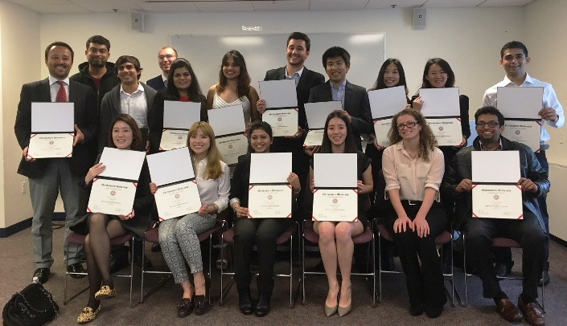
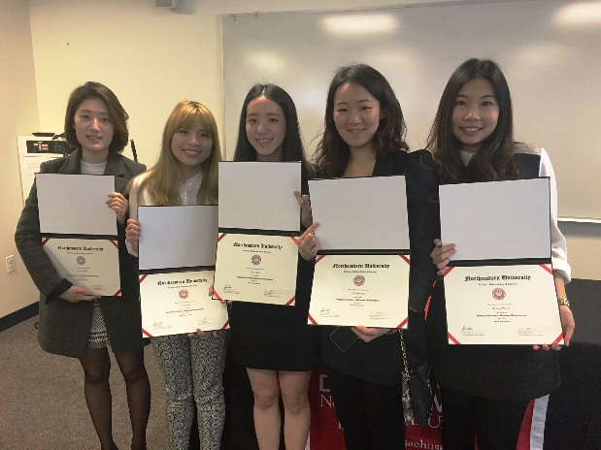
Graduate Certificate Programs - Study and work in the US!
4- and 8- Months Program
5 MBA courses
No TOEFL or GMAT required
Credits may transfer to many Masters or MBA
Start Dates: January, May and September
Eligible for OPT
  With the exception of Study Abroad Certificate which is 12 credits and 4 month and its not eligible for OPT.

Slide 4

Upon Completing a Graduate Certificate
  Return back to home country
  Carry 15 credits forward into another Masters/MBA program
  Apply for OPT to work in the US
Notes:
WORKING AFTER YOUR CERTIFICATE
Optional Practical Training (OPT)
Successful completion of the Graduate Certificate Program qualifies students to apply for OPT. OPT authorizes students to work anywhere in the US in a field related to business for 12 months. At any point during the 12 months, students can move into a Masters degree and complete what is remaining of the 12 months after the Masters degree.
Northeastern does not have a job placement service however we will give students a list of job placement agencies around Boston and students can work with these companies to secure a position.
http://www.northeastern.edu/issi/opt.html

Slide 5

Optional Practical Training
  This Graduate Certificate Program is a vehicle to work in the US
    12 months OPT
    Full-time, paid work
    Work with job placement agencies in Boston
    NU seminars to prepare for job-seeking
    Can seek another OPT after a certificates / masters program

Slide 6
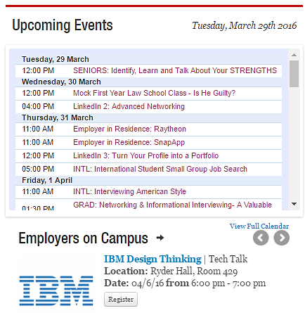

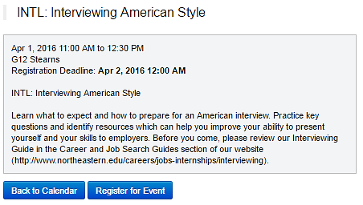
Northeastern Career Service
Northeastern University prides itself on having a top ranked career development department, that has been consistently ranked #1 or #2 by The Princeton Review since 2011 and #1 Career Services by College Magazine in 2014.
Sample Events Calendar
Sample Event

Slide 7
Potential Sequences of Opportunities
Option 1
Graduate Certificate
Option 2
Graduate Certificate
OPT
Option 3
Graduate Certificate
Masters
Option 4
Graduate Certificate
OPT
Masters
Option 5
Graduate Certificate
Masters
OPT
Option 6
Graduate Certificate
OPT
Masters
OPT

Slide 8
Matriculation into Another Program
MBAs
$53,400 +
16 months
45more credits
Take GRE
Graduate Certificate
$23,310
No GMAT
8 months
15 credits
Leadership
$20,000 +
12 months
30 more credits
No GRE
Corp. & Org Comm
MS*
Proj Mgmt
*If a student earns a 3.000 cumulative gpa in the Grad Cert they are guaranteed admission into the MS programs
Non-profit

Slide 9
Masters programs your credits can move into
MBA’s:
Online
Professional MBA
MS Degrees:
Project Management
Digital Media
Leadership
Nonprofit Management
Human Services
Corporate and Organizational Communication
MS Degree Continued…
Global Studies and International Relations
Technological Entrepreneurship
Regulatory Affairs for Drugs, Biologics and Medical Devices
Other Master’s Degrees:
MPS Geographic Information Technology
MPS Informatics
MSTC Technical Communication

Slide 10
Cost of Graduate Certificate for i20
8-month certificates
4-month certificates
Tuition – 22,800
Fees - 510
Tuition and Fees $ 23,310
Board and room 12,400
Books and Supplies 1,300
Medical Care 2,384
Personal 1,700
Living expenses $ 17,784
TOTAL: $ 41,094
Tuition – 18,240
Fees - 380
Tuition and Fees $ 18,620
Board and room 6,200
Books and Supplies 1,300
Medical Care 2,384
Personal 850
Living expenses $ 10,734
TOTAL: $ 33,914
Estimated cost per credit for 16/17 AY = $1,520
The monthly payment plan administered through TuitionPay, allows you to divide your educational costs into smaller, more manageable installments. To enroll, please visit TuitionPay or call 800.635.0120
All of your payments will be made through the NUPAY online portal and can be wire payment, checking account, etc. here is more information
For more information about i20 documentation and instructions for this program please click here.

Slide 11
Application and Admissions
Must have a bachelor’s degree with 3.0 (out of 4.0) cumulative gpa or equivalent.
Required application materials include:
A submitted online application ( fee waiver cert-crid-9828 )
A current resume
Professional letter of recommendation – preferably from a past manager
Personal statement
Transcripts (unofficial okay for review)
An intake interview can be conducted in lieu of a TOEFL or IELTS
Deadlines
Intake | Initial i20 | Transfer i20
January | November 1 | December 1
May | March 1 | April 1
September | July 1 | August 1

