Slide 1
Want to know more about WVU?
Molly Roush
International Admissions Counselor
Molly.Roush@mail.wvu.edu
Office: +1 304 239 3622
Mobile & WhatsApp: +1 304 692 1181
Dr. Radhey Sharma
Professor and Associate Vice President for
Global Strategies and International Affairs
Radhey.Sharma@mail.wvu.edu
Office: +1 304 239 9920
APRIL FEE WAIVER CODE: 2017AP

Slide 2
Engineering, Business & Economics at WVU: Undergraduate and Beyond

Slide 4
WVU IN THE NEWS

Slide 5
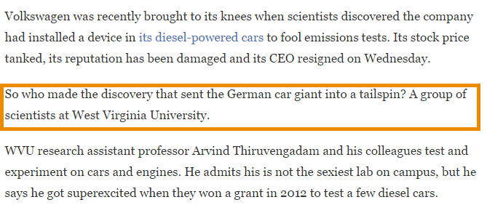
“WVU Researchers Help Bust Volkswagen for Pollution Violations”

Slide 14
Wild & Wonderful West Virginia
Snow Sports
Rafting
Ziplining
Hiking

Slide 16
467
STUDENT ORGANIZATIONS
29 CULTURAL & INTERNATIONAL CLUBS
INTERNATIONAL STUDENT ORGANIZATION (ISO)
INDIAN STUDENT ASSOCIATION
ASSOCIATION FOR INDIA'S DEVELOPMENT (AID)
37 ENGINEERING SCIENCES ORGANIZATIONS
ENGINEERS WITHOUT BORDERS
INSTITUTE OF INDUSTRIAL AND SYSTEMS ENGINEERS
SOCIETY OF WOMEN ENGINEERS
19 BUSINESS & ECONOMICS ORGANIZATIONS
DECA
STUDENT INVESTMENT CLUB
MANAGEMENT INFORMATION SYSTEMS ASSOCIATION (MISA)

Slide 21
Minimum Requirements for Undergraduate Admissions
Freshman applicants must have at least a secondary school Grade Point Average (GPA) of a 2.5 on a 4.0 scale.
Transfer applicants must have a GPA of at least a 2.0 on a 4.0 scale in all college/university courses attempted.
All undergraduate applicants must meet the English Proficiency requirement (TOEFL iBT score of 61 or IELTS score of 6.0) or request conditional admission and complete an Intensive English Program (IEP) application.
International applicants are not generally required to submit SAT or ACT scores. However, SAT/ACT scores are used for determining some scholarship eligibility and are required for some academic programs.
*Meeting the minimum requirements does not guarantee admission. Admission is decided upon review of all application materials.

Slide 22
International Scholarships for Undergraduates
Level 1 Requirements
3.5 Incoming GPA
3.0 GPA & 30 Credit Hours to Renew Each Year
$7,000
per year
$6,000
per year
Level 2 Requirements
3.25 Incoming GPA
2.75 GPA & 30 Credit Hours to Renew Each Year
Level 3 Requirements
3.0 Incoming GPA
2.75 & 30 Credit Hours to Renew Each Year
$5,000
per year

Slide 23
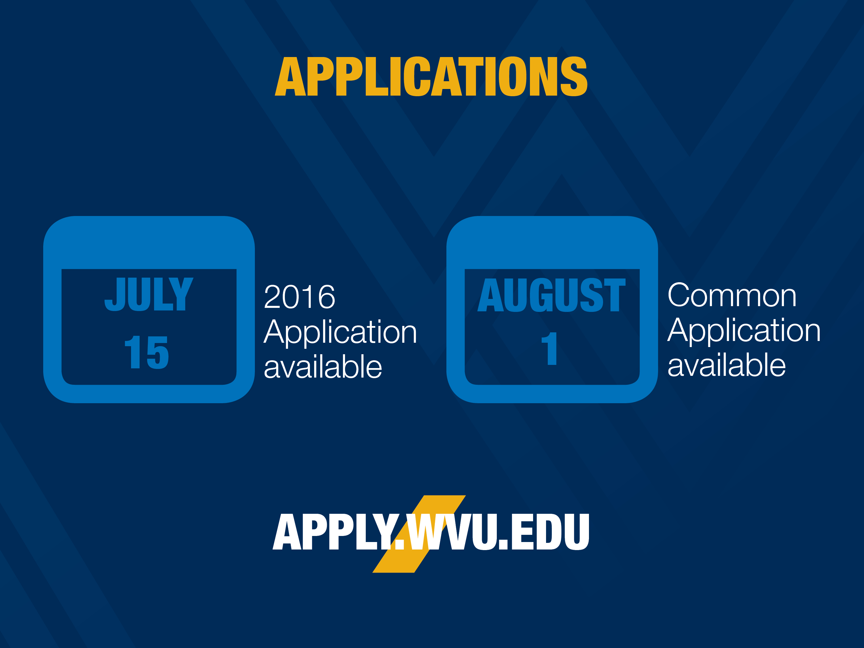
Fall 2017
Apply By
June 1st
Spring 2018
Apply By
October 1st
Summer 2018
Apply By:
February 15th

Slide 25
Engineering Tracks
Engineering Track 1/Computer Science (4 years)
High School GPA | MATH ACT/SAT
3.0 | ACT: 28 or
 | SAT Pre-March 2016: 630 or
 | SAT March 2016 or later: 650
Engineering Track 2 (4 – 4.5 years)
High School GPA | MATH ACT/SAT
2.75 | ACT: 26 or
 | SAT Pre-March 2016: 580 or
 | SAT March 2016 or later: 600
Engineering Track 3 (5 years)
High School GPA | MATH ACT/SAT
2.5 | ACT: 22 or
 | SAT Pre-March 2016: 540 or
 | SAT March 2016 or later: 570

Slide 26
ENGINEERING DEGREES
 | Bachelor’s | Master’s | Doctoral
Aerospace Engineering | ✺ | ♢ | ✖
Biomedical Engineering | ✺
Biometric Systems | ✺
Chemical Engineering | ✺ | ♢ | ✖
Civil Engineering | ✺ | ♢ | ✖
Computer Engineering | ✺ |  | ✖
Computer Science | ✺ | ♢ | ✖
Electrical Engineering | ✺ | ♢ | ✖
Industrial Engineering | ✺ | ♢ | ✖
Mechanical Engineering | ✺ | ♢ | ✖
Mining Engineering | ✺ | ♢ | ✖
Petroleum & Natural Gas Engineering | ✺ | ♢ | ✖
Energy Systems Engineering |  | ♢
Industrial Hygiene |  | ♢
Materials Science & Engineering |  | ♢ | ✖
Safety Management |  | ♢
Software Engineering |  | ♢
Occupational Safety & Health |  |  | ✖

Slide 27
Engineering Scholarships
Engineering Excellence Level 1:
GPA: 3.8+ One of the following:
Math ACT: 32 & Composite ACT: 30
Math SAT: 720 & Total SAT Pre-March 2016: 1340
Math SAT: 750 & SAT March 2016 SAT or later: 1400
$5,500
per year
Engineering Excellence Level 2:
GPA: 3.6+ One of the following:
Math ACT: 29 & Composite ACT: 26
Math SAT: 650 & Total SAT Pre-March 2016: 1180
Math SAT: 670 & SAT March 2016 SAT or later: 1250
$4,500
per year

Slide 28
STATLER COLLEGE OF ENGINEERING: DID YOU KNOW?
$66,000
Average starting salary of our graduates
84%
Career placement rate
3,300
Approximate number of undergraduates
612
Average math SAT score
27.1
Average math ACT score

Slide 29
College or Department Name

Slide 30
Our Accreditation rating is one that only 5% of all business colleges in the world achieve.
The Association to Advance Collegiate Schools of Business Accredited
Business Accredited
Accounting Accredited
Higher Learning Commission Accredited
Ranked among the top Business Schools, according to
Bloomberg Businessweek
Ranked #5 Top Undergraduate Business School for Ethics by Bloomberg Businessweek
Ranked #9 Undergraduate Business School for ROI (Return on Investment)

Slide 31
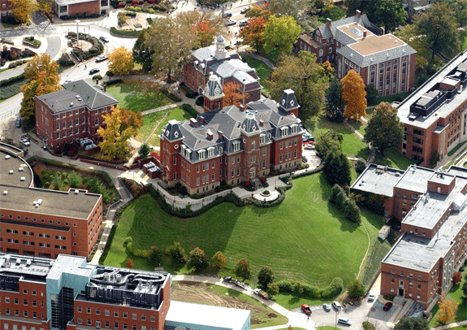
B&E Majors
Areas of Emphasis in the Management Major
Human Resources
International Business
Bachelor of Science in Business Administration (BSBA)
Accounting
Finance
Entrepreneurship
General Business
Global Supply Chain Management
Hospitality & Tourism Management
Management
Management Information Systems
Marketing
Bachelor of Science (BS)
Economics

Slide 32
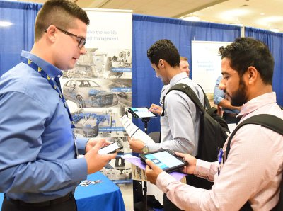
B&E Center for Career Development
Function
Internships & job placement
Resume & interview workshops, networking opportunities
Business – specific career fairs
On-campus employment interviews
Provides the necessary tools for a successful job search
Utilizing the Center for Career Development
Students are encouraged to schedule an appointment during freshman year
Fun Fact: Nearly 80 Fortune 500 companies recruit at B&E!
Wide screen
Standard
16x9
4x3

Slide 33
B&E After Undergrad
Graduate Degree Programs
MBA + 6 Dual Degree Programs
Master of Professional Accountancy
MS Industrial Relations
MS Business Data Analytics*
MS Finance
MS Forensic and Fraud Examination*
Ph.D. Economics
Ph.D. Business Administration
Dual Degrees In:
MBA – M.S. in Industrial Relations
MBA – M.S. in Sports Management
MBA – M.S. in Sports Management
MBA – Doctorate of Dental Surgery (DDS)
MBA – M.D.: Medical Student Step-Out Year
MBA – Master of Public Health (MPH)
*Online Degree Only

Slide 35
Want to know more about WVU?
Molly Roush
International Admissions Counselor
Molly.Roush@mail.wvu.edu
Office: +1 304 239 3622
Mobile & WhatsApp: +1 304 692 1181
Dr. Radhey Sharma
Professor and Associate Vice President for Global Strategies and International Affairs
Radhey.Sharma@mail.wvu.edu
Office: +1 304 239 9920
APRIL FEE WAIVER CODE: 2017AP

